Slide 1
MongoDB Operators
MongoOP_Bipin

Slide 2
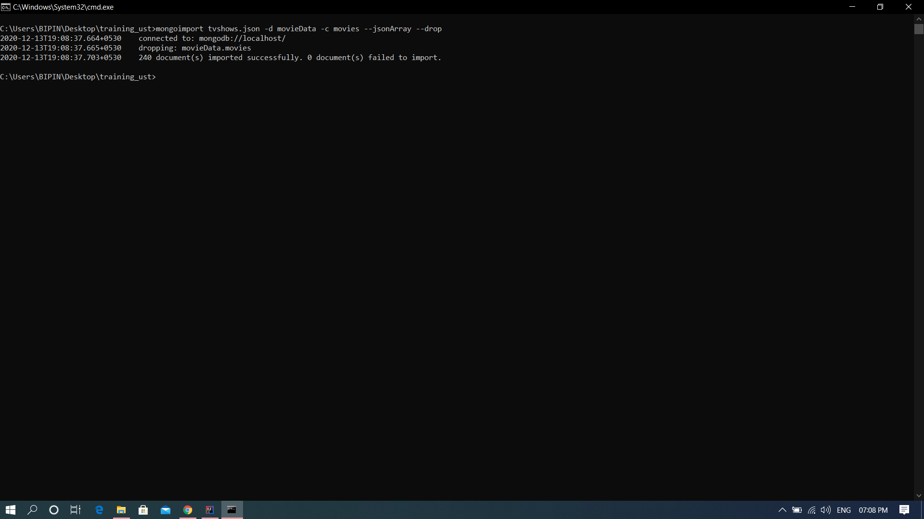
mongoimport command to import database

Slide 3
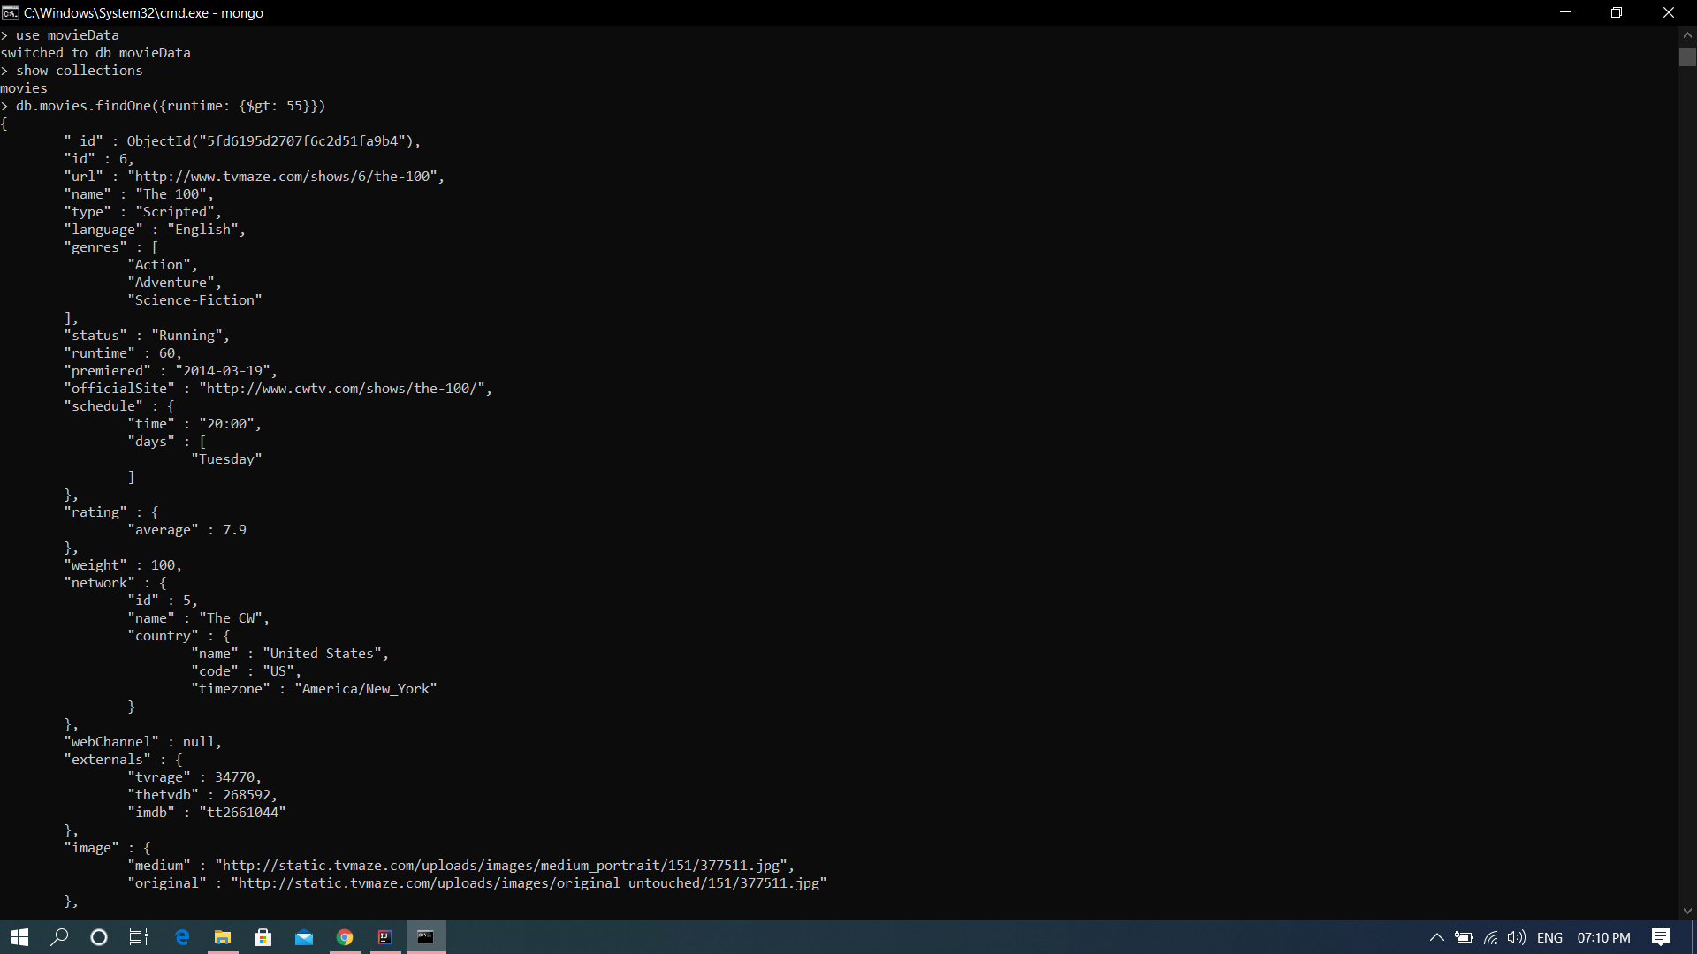
$gt

Slide 4
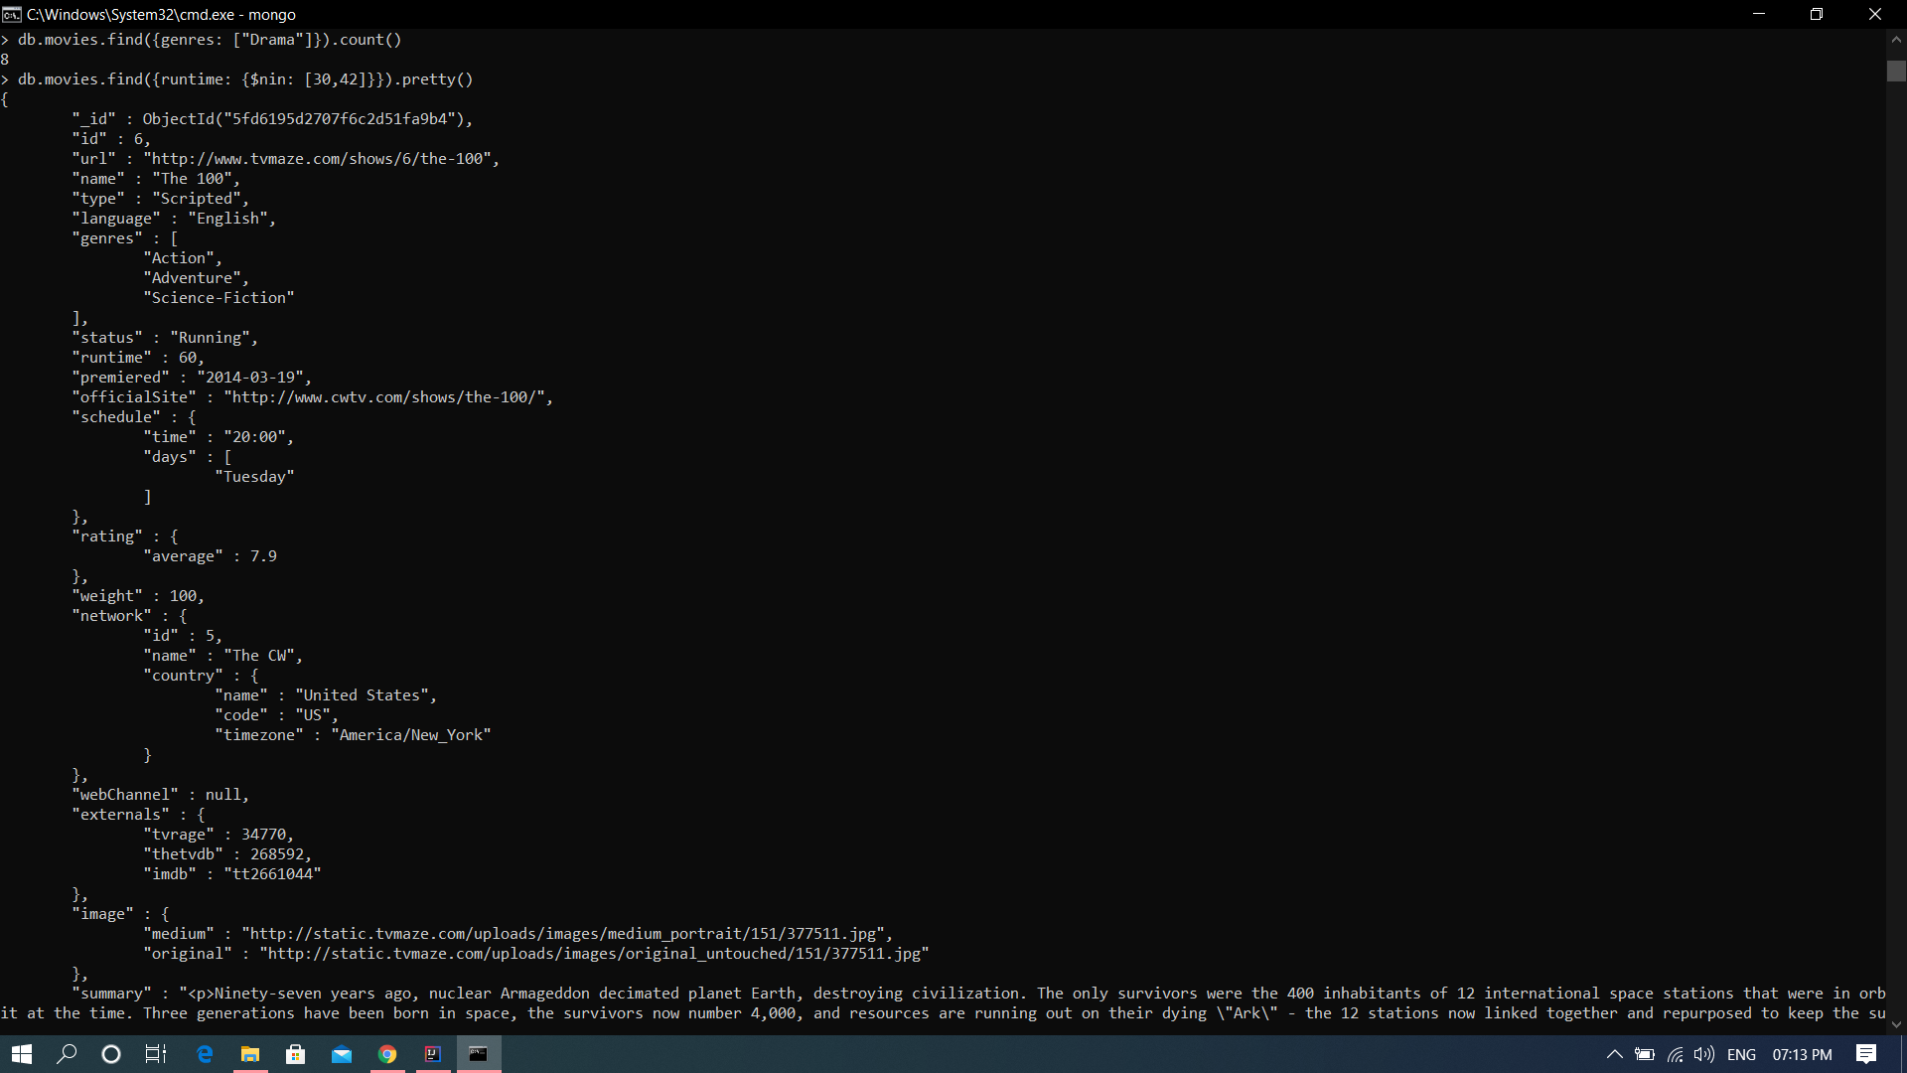
$nin

Slide 5
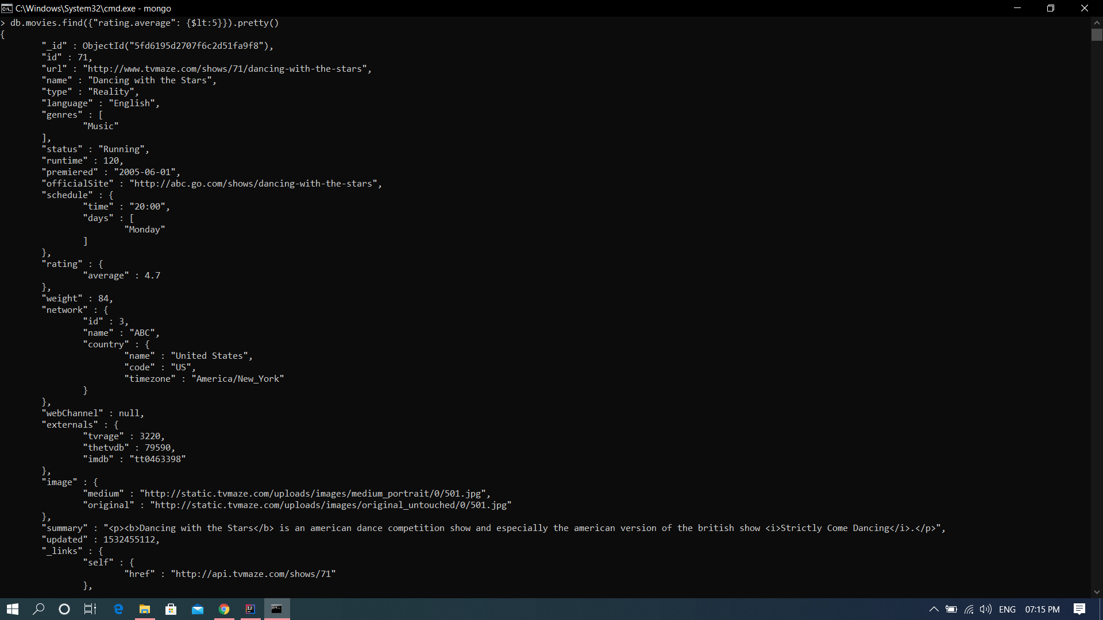
$lt

Slide 6
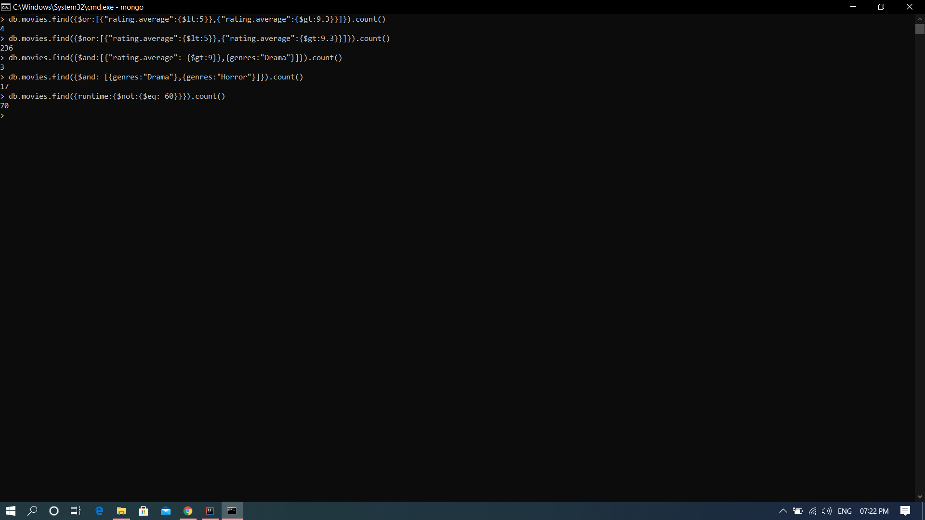
$or, $nor, $and, $eq

Slide 7
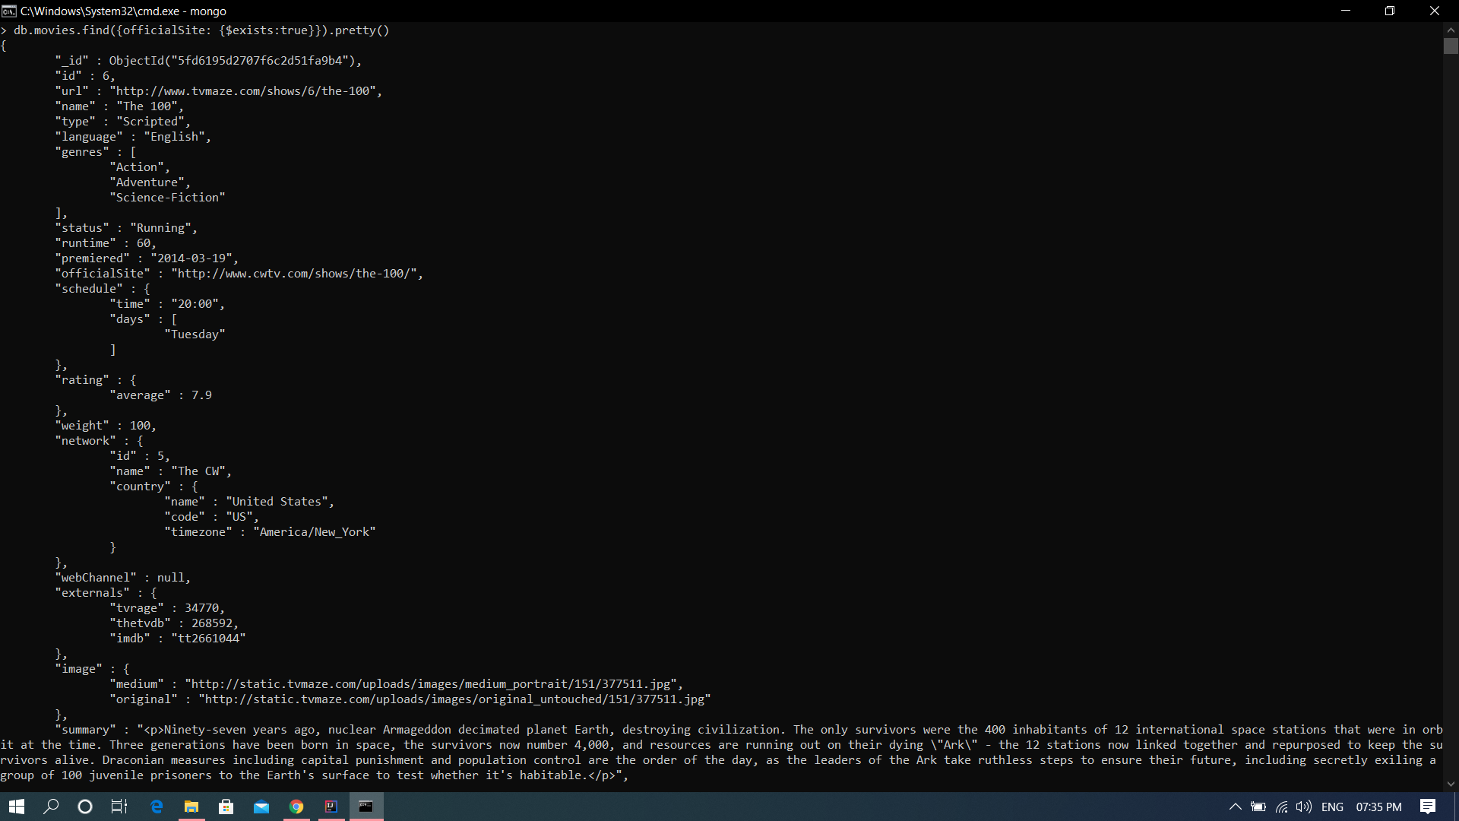
$exists

Slide 8
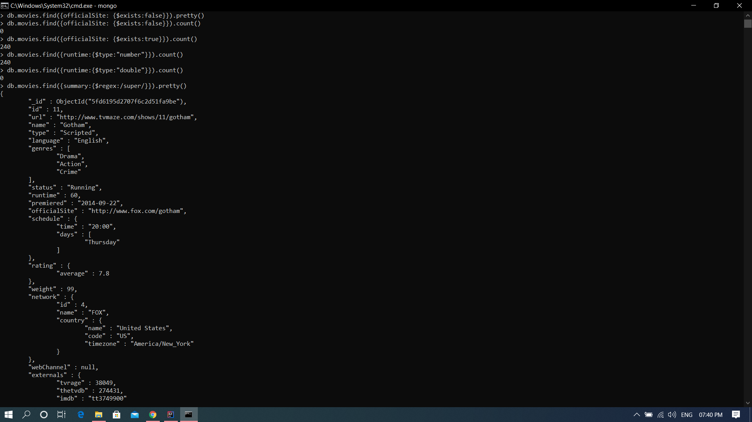
$type, $regex

Slide 9
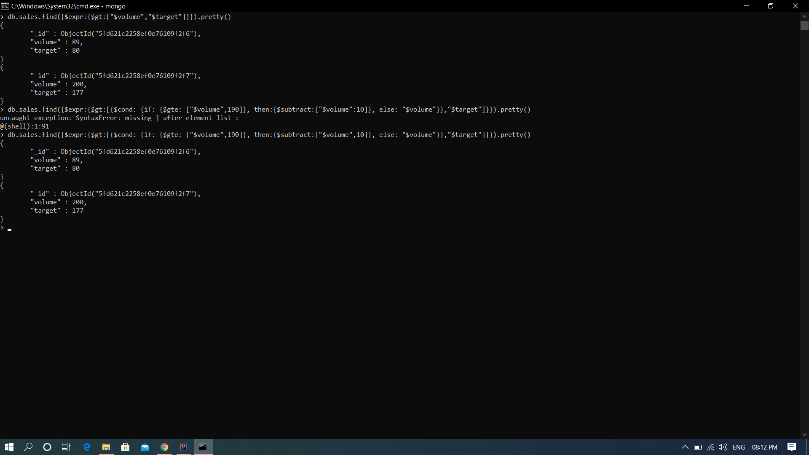
$expr, $cond (if.. then.. else..)

Slide 10
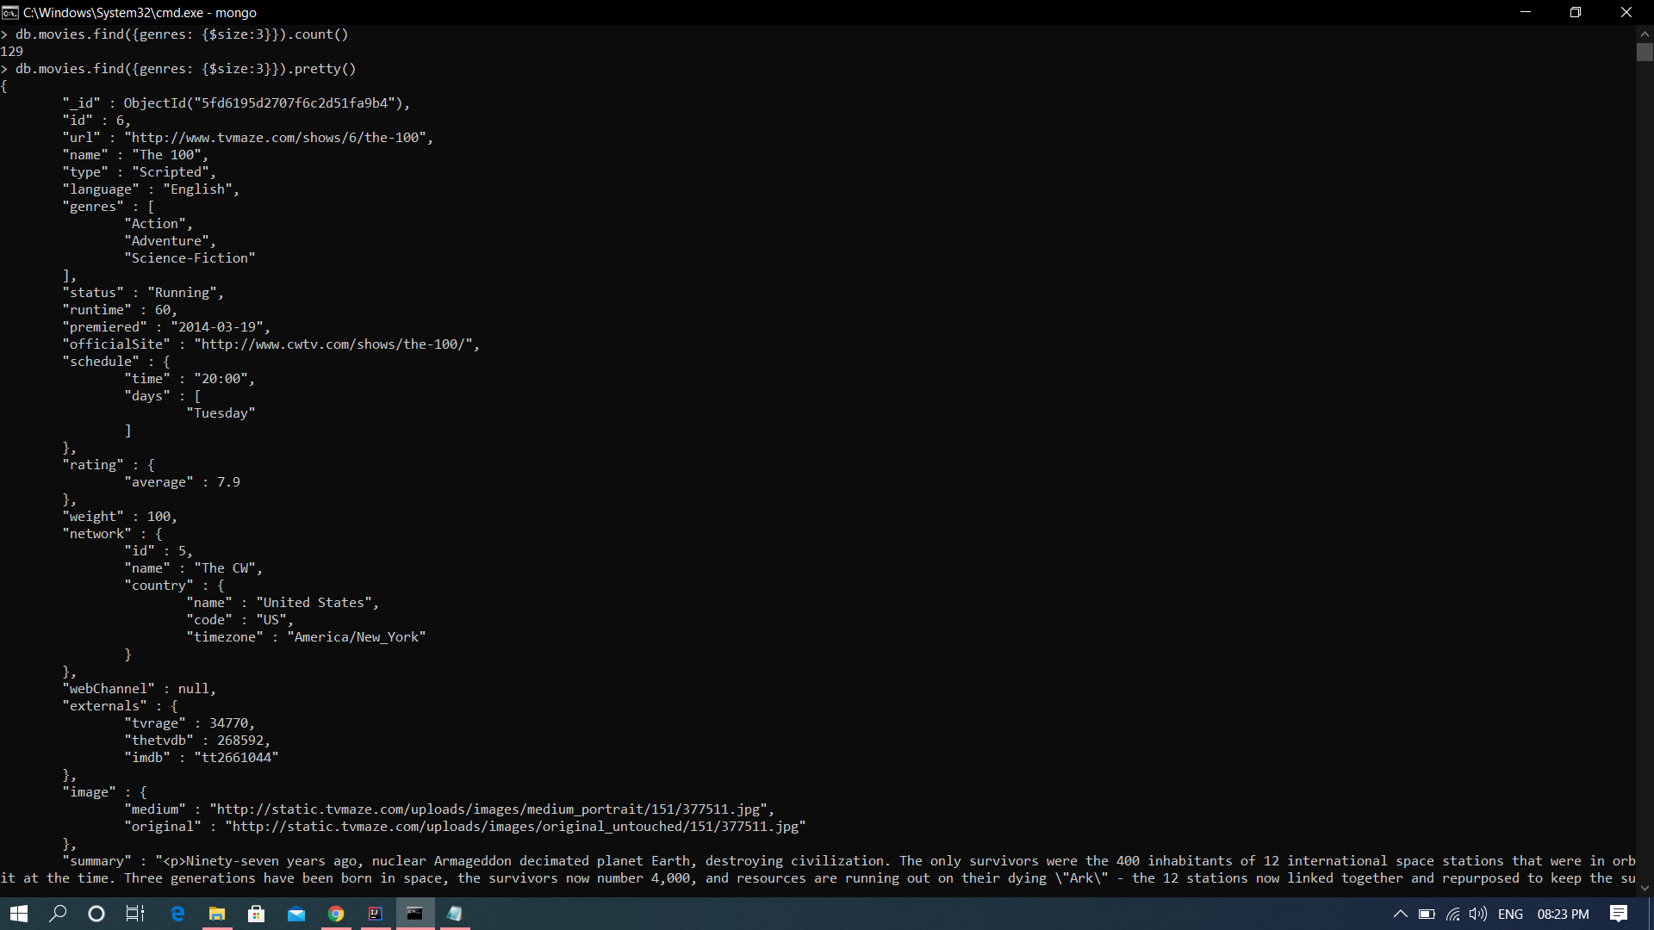
$size

Slide 11
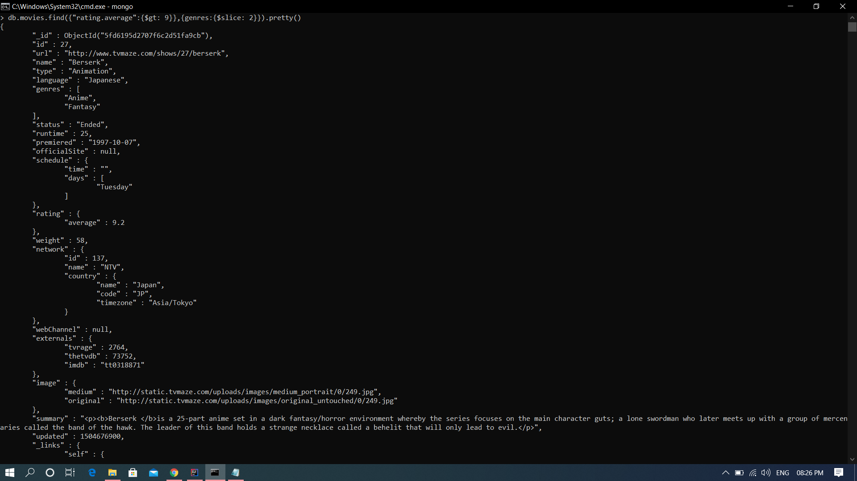
$slice

Slide 12
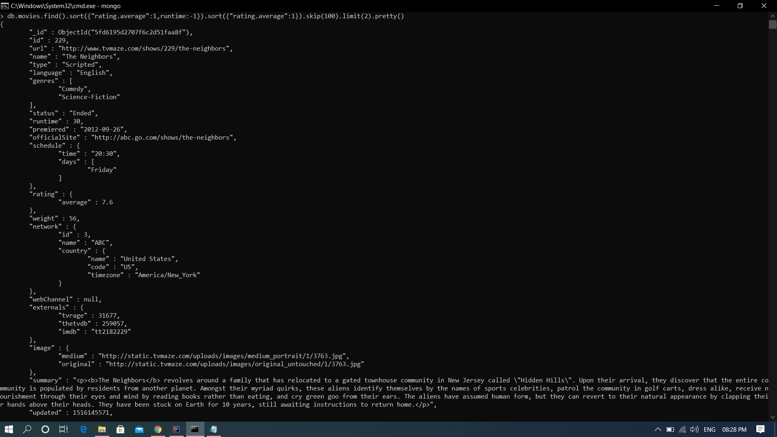
sort and skip

